Slide 1
Chapter 2. Machine Instructions and Programs

Slide 2
Objectives
Machine instructions and program execution, including branching and subroutine call and return operations.
Number representation and addition/subtraction in the 2’s-complement system.
Addressing methods for accessing register and memory operands.
Assembly language for representing machine instructions, data, and programs.
Program-controlled Input/Output operations.

Slide 3
Number, Arithmetic Operations, and Characters

Slide 4
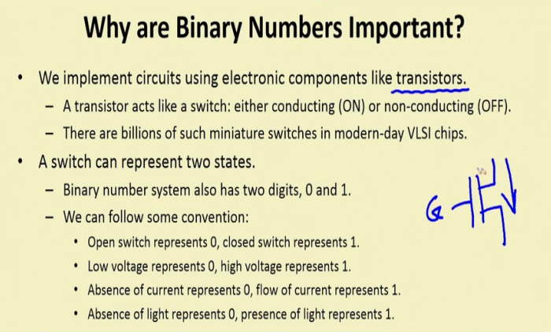

Slide 5
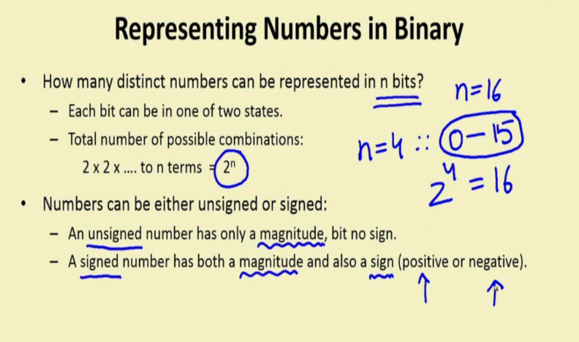

Slide 6
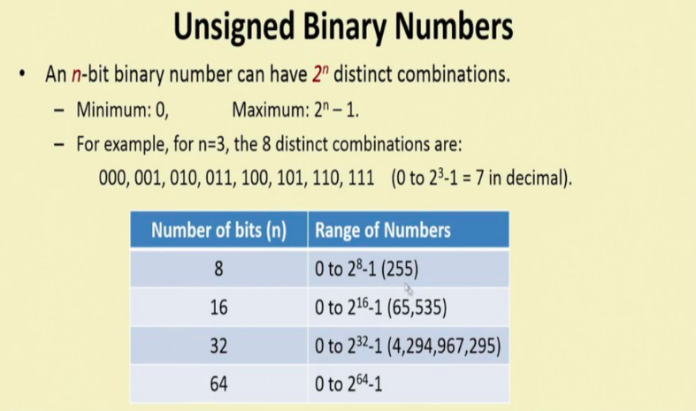

Slide 7
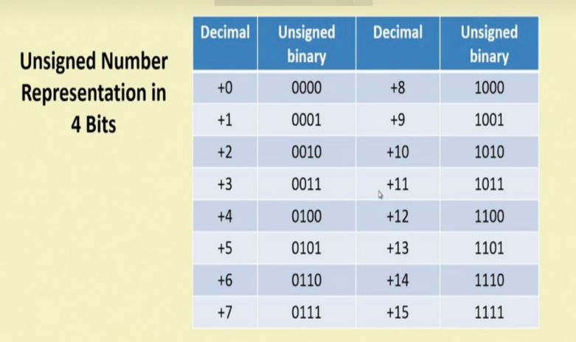

Slide 8
Signed Integer
3 major representations:
Sign and magnitude
One’s complement
Two’s complement
Assumptions:
4-bit machine word
16 different values can be represented
Roughly half are positive, half are negative

Slide 9
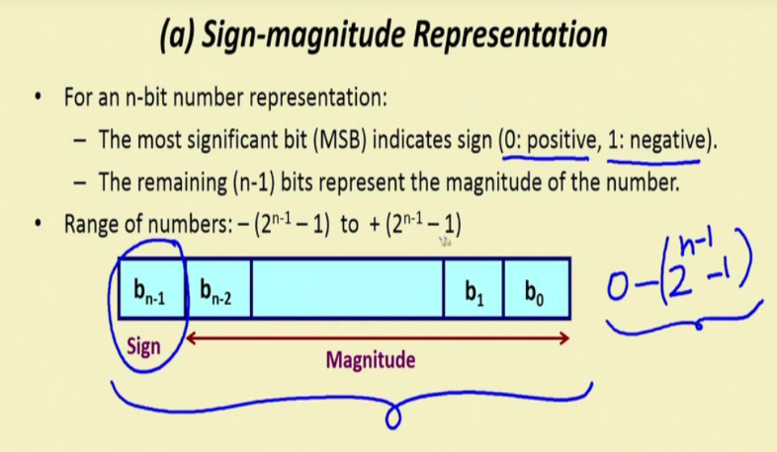

Slide 10
Sign and Magnitude Representation
High order bit is sign: 0 = positive (or zero), 1 = negative
Three low order bits is the magnitude: 0 (000) thru 7 (111)
Number range for n bits = +/-2^{n-1} -1
Two representations for 0

Slide 11
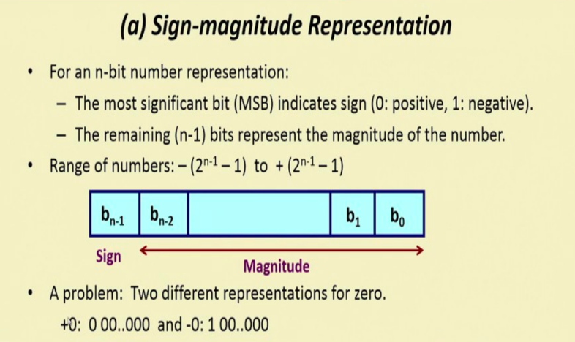

Slide 12
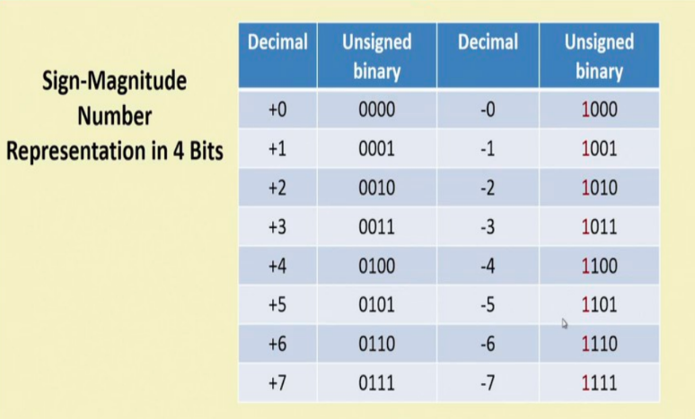

Slide 13
One’s Complement Representation
Subtraction implemented by addition & 1's complement
Still two representations of 0! This causes some problems
Some complexities in addition

Slide 14
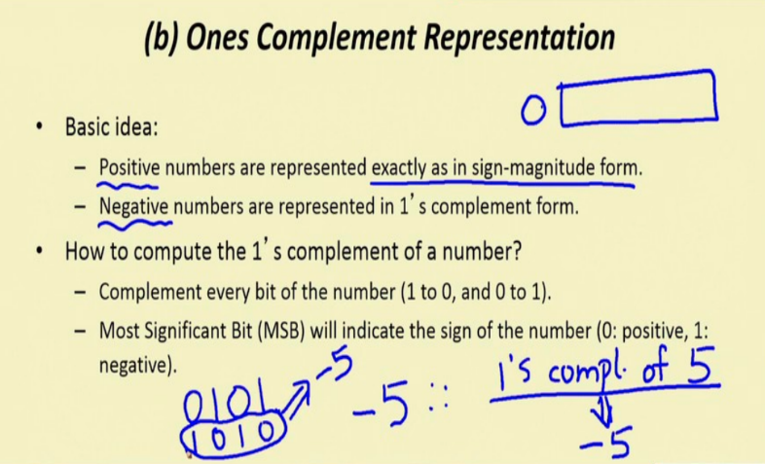

Slide 15
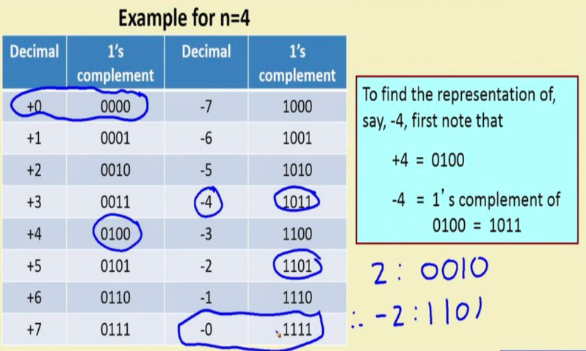

Slide 16
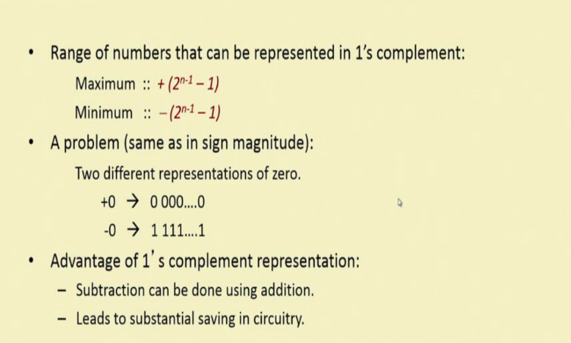

Slide 17
Two’s Complement Representation
like 1's comp
except shifted
one position
clockwise
Only one representation for 0
One more negative number than positive number

Slide 18
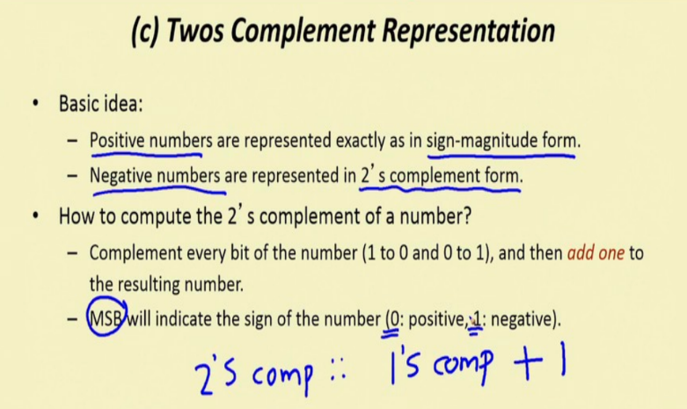

Slide 19
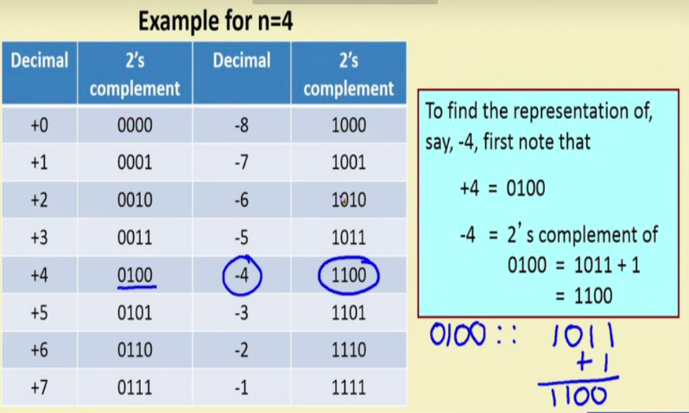

Slide 20
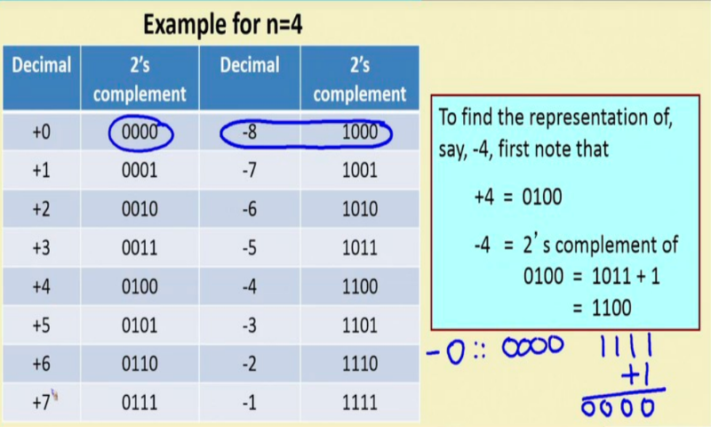

Slide 21
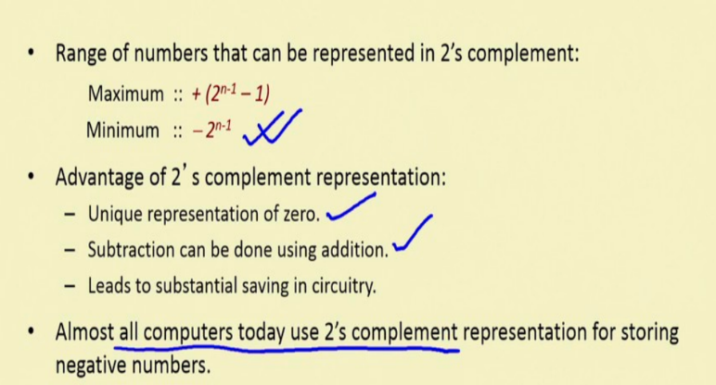

Slide 22
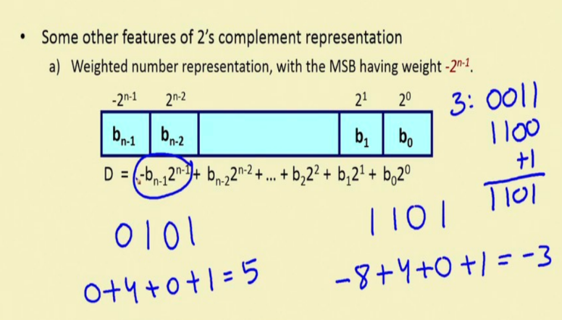

Slide 23
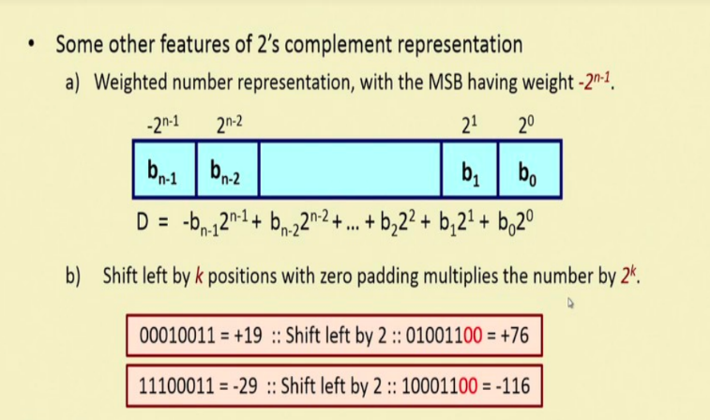

Slide 24
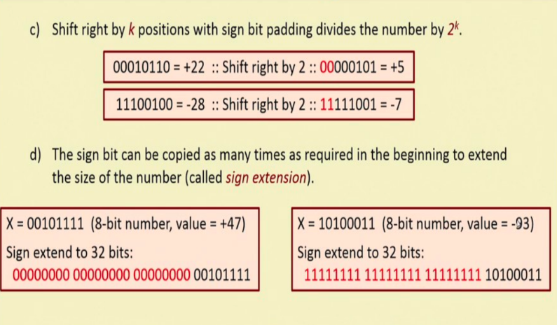

Slide 25
Binary, Signed-Integer Representations
Page 28
B
V
alues represented
Sign and
b
3
b
2
b
1
b
0
magnitude
1'
s complement
2'
s complement
0
1
1
1
+
7
+
7
+
7
0
1
1
0
+
6
+
6
+
6
0
1
0
1
+
5
+
5
+
5
0
1
0
0
+
4
+
4
+
4
0
0
1
1
+
3
+
3
+
3
0
0
1
0
+
2
+
2
+
2
0
0
0
1
+
1
+
1
+
1
0
0
0
0
+
0
+
0
+
0
1
0
0
0
-
0
-
7
-
8
1
0
0
1
-
1
-
6
-
7
1
0
1
0
-
2
-
5
-
6
1
0
1
1
-
3
-
4
-
5
1
1
0
0
-
4
-
3
-
4
1
1
0
1
-
5
-
2
-
3
1
1
1
0
-
6
-
1
-
2
1
1
1
1
-
7
-
0
-
1
Figure 2.1. Binary, signed-integer representations.

Slide 26
Addition and Subtraction – 2’s Complement
4
+ 3
7
0100
0011
0111
-4
+ (-3)
-7
1100
1101
11001
If carry-in to the high
order bit =
carry-out then ignore
carry
if carry-in differs from
carry-out then overflow
4
- 3
1
0100
1101
10001
-4
+ 3
-1
1100
0011
1111
Simpler addition scheme makes twos complement the most common
choice for integer number systems within digital systems

Slide 27
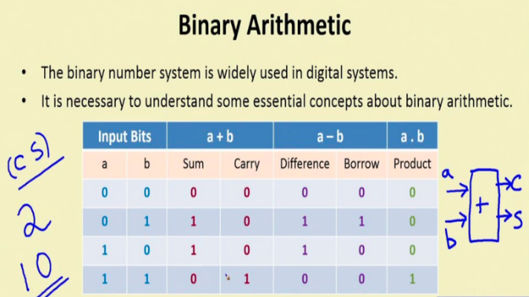

Slide 28
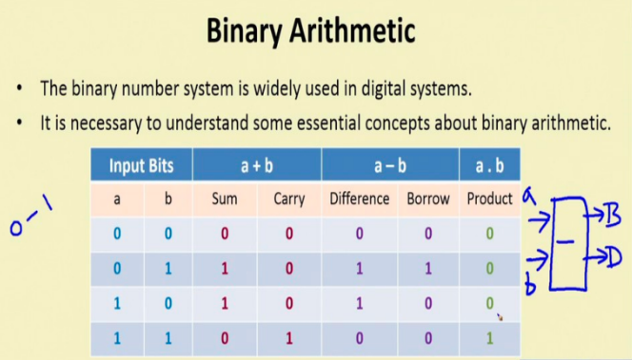

Slide 29
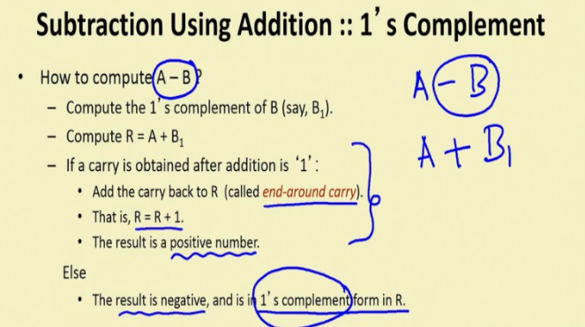

Slide 30
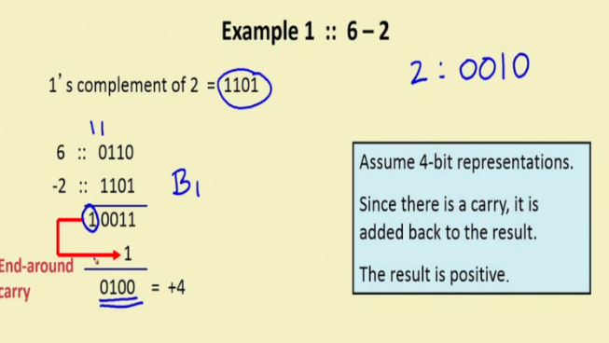

Slide 31
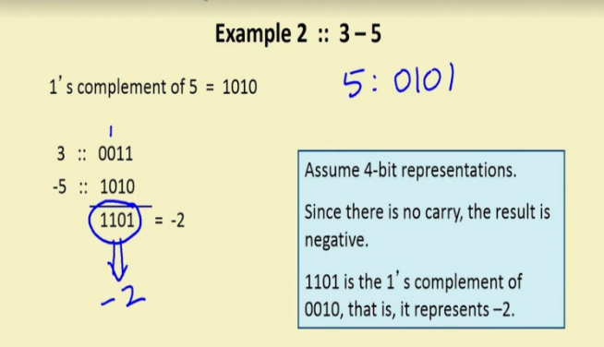

Slide 32
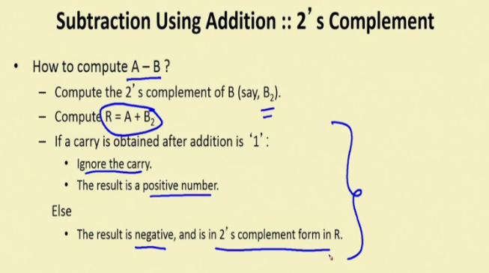

Slide 33
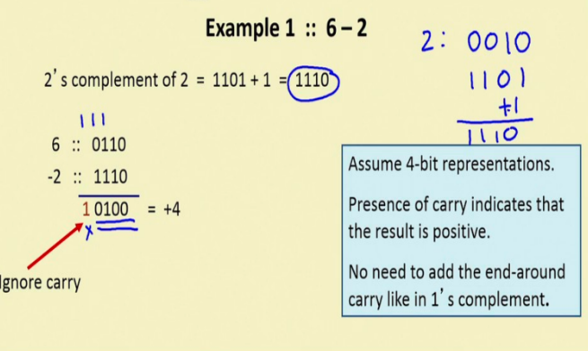

Slide 34
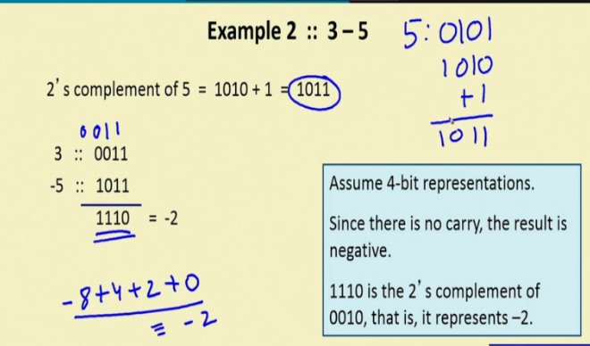

Slide 35
2’s-Complement Add and Subtract Operations
(a)
0 0 1 0
(
+
2
)
(b)
0 1 0 0
(
+
4
)
Page 31
+
0 0 1 1
(
+
3
)
+
1 0 1 0
(
-
6
)
0 1 0 1
(
+
5
)
1 1 1 0
(
-
2
)
(c)
1 0 1 1
(
-
5
)
(d)
0 1 1 1
(
+
7
)
+
1 1 1 0
(
-
2
)
+
1 1 0 1
(
-
3
)
1 0 0 1
(
-
7
)
0 1 0 0
(
+
4
)
(e)
1 1 0 1
(
-
3
)
1 1 0 1
-
1 0 0 1
(
-
7
)
+
0 1 1 1
0 1 0 0
(
+
4
)
(f)
0 0 1 0
(
+
2
)
0 0 1 0
-
0 1 0 0
(
+
4
)
+
1 1 0 0
1 1 1 0
(
-
2
)
(g)
0 1 1 0
(
+
6
)
0 1 1 0
-
0 0 1 1
(
+
3
)
+
1 1 0 1
0 0 1 1
(
+
3
)
(h)
1 0 0 1
(
-
7
)
1 0 0 1
-
1 0 1 1
(
-
5
)
+
0 1 0 1
1 1 1 0
(
-
2
)
(i)
1 0 0 1
(
-
7
)
1 0 0 1
-
0 0 0 1
(
+
1
)
+
1 1 1 1
1 0 0 0
(
-
8
)
(j)
0 0 1 0
(
+
2
)
0 0 1 0
-
1 1 0 1
(
-
3
)
+
0 0 1 1
0 1 0 1
(
+
5
)
Figure 2.4. 2's-complement Add and Subtract operations.

Slide 36
Overflow - Add two positive numbers to get a negative number or two negative numbers to get a positive number
-1
+0
-1
+0
-2
1111
0000
+1
-2
1111
0000
+1
-3
1110
0001
-3
1110
0001
1101
+2
1101
+2
-4
0010
-4
0010
1100
0011
+3
1100
0011
+3
-5
1011
-5
0100
+4
1011
0100
+4
-6
1010
-6
1010
0101
+5
0101
+5
1001
0110
1001
0110
-7
1000
+6
-7
+6
0111
1000
0111
-8
+7
-8
+7
5 + 3 = -8
-7 - 2 = +7

Slide 37
Overflow Conditions
0 1 1 1
0 1 0 1
0 0 1 1
1 0 0 0
1 0 0 0
1 0 0 1
1 1 0 0
1 0 1 1 1
5
3
-8
-7
-2
7
Overflow
Overflow
0 0 0 0
0 1 0 1
0 0 1 0
0 1 1 1
1 1 1 1
1 1 0 1
1 0 1 1
1 1 0 0 0
5
2
7
-3
-5
-8
No overflow
No overflow
Overflow when carry-in to the high-order bit does not equal carry out

Slide 38

Sign Extension
Task:
Given w-bit signed integer x
Convert it to w+k-bit integer with same value
Rule:
Make k copies of sign bit:
X ′ = x_{w–1} ,…, x_{w–1} , x_{w–1} , x_{w–2} ,…, x₀
w
X
• • •
k copies of MSB
• • •
X ′
• • •
• • •
k
w

Slide 39

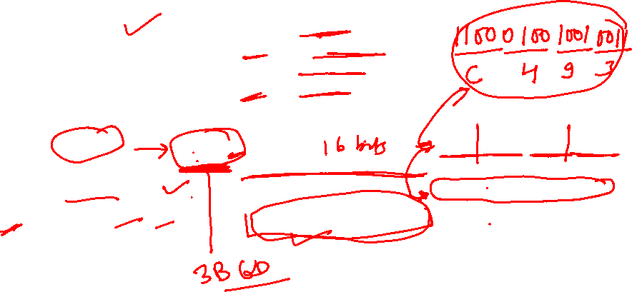
Sign Extension Example
short int x = 15213;
int ix = (int) x;
short int y = -15213;
int iy = (int) y;

Slide 40
Memory Locations, Addresses, and Operations

Slide 41
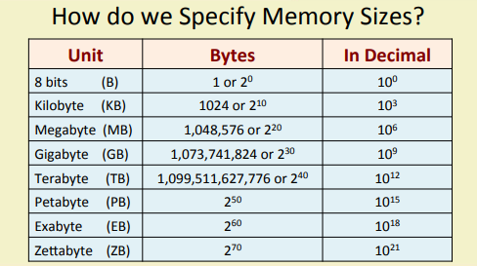
How do we Specify Memory Sizes

Slide 42
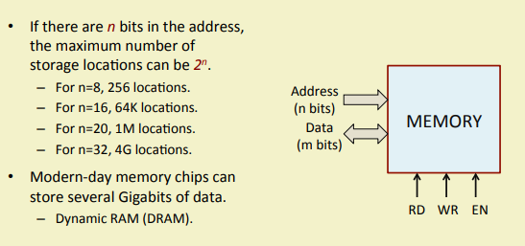
How do we Specify Memory Sizes

Slide 43
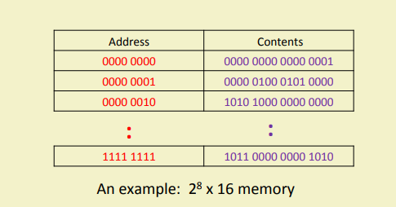

Slide 44
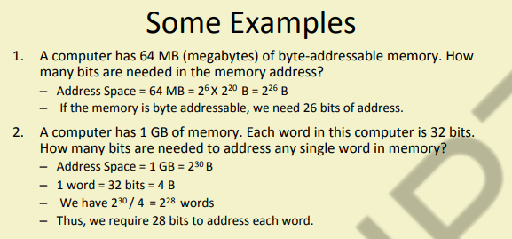

Slide 45
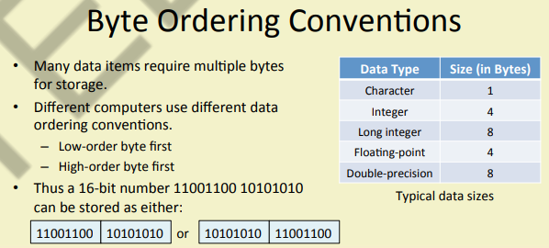

Slide 46
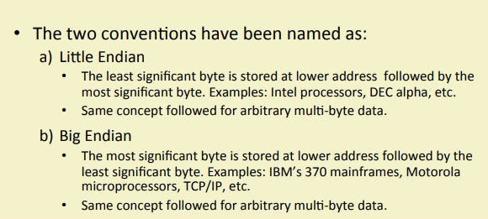

Slide 47
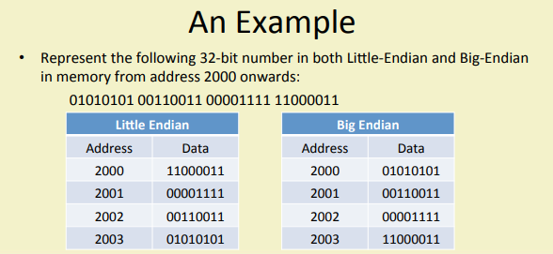

Slide 48
Examples
32-bit Integer 0x12345678:
Big-Endian: 0x12 0x34 0x56 0x78
Little-Endian: 0x78 0x56 0x34 0x12
32-bit Integer 0xAABBCCDD:
Big-Endian: 0xAA 0xBB 0xCC 0xDD
Little-Endian: 0xDD 0xCC 0xBB 0xAA
32-bit Integer 0xDEADBEEF:
Big-Endian: 0xDE 0xAD 0xBE 0xEF
Little-Endian: 0xEF 0xBE 0xAD 0xDE
32-bit Integer 0x80000000 (the minimum signed integer):
Big-Endian: 0x80 0x00 0x00 0x00
Little-Endian: 0x00 0x00 0x00 0x80
32-bit Integer 0xFFFFFFFF (all bits set to 1):
Big-Endian: 0xFF 0xFF 0xFF 0xFF
Little-Endian: 0xFF 0xFF 0xFF 0xFF

Slide 49
Memory Location, Addresses, and Operation
n
bits
Memory consists of many millions of storage cells, each of which can store 1 bit.
Data is usually accessed in n-bit groups. n is called word length.
first word
second word
•
•
•
i
th word
•
•
•
last word
Figure 2.5. Memory words.

Slide 50
Memory Location, Addresses, and Operation
32-bit word length example
32 bits
•
•
•
b
31
b
30
b
1
b
0
Sign bit:
b
31
=
0
for positive numbers
b
31
=
1
for negative numbers
(a) A signed integer
8 bits
8 bits
8 bits
8 bits
ASCII
ASCII
ASCII
ASCII
character
character
character
character
(b) Four characters

Slide 51
Memory Location, Addresses, and Operation
To retrieve information from memory, either for one word or one byte (8-bit), addresses for each location are needed.
A k-bit address memory has 2^{k} memory locations, namely 0 – 2^{k}-1, called memory space.
24-bit memory: 2²⁴ = 16,777,216 = 16M (1M=2²⁰)
32-bit memory: 2³² = 4G (1G=2³⁰)
1K(kilo)=2¹⁰
1T(tera)=2⁴⁰

Slide 52
Memory Location, Addresses, and Operation
It is impractical to assign distinct addresses to individual bit locations in the memory.
The most practical assignment is to have successive addresses refer to successive byte locations in the memory – byte-addressable memory.
Byte locations have addresses 0, 1, 2, … If word length is 32 bits, they successive words are located at addresses 0, 4, 8,…

Slide 53
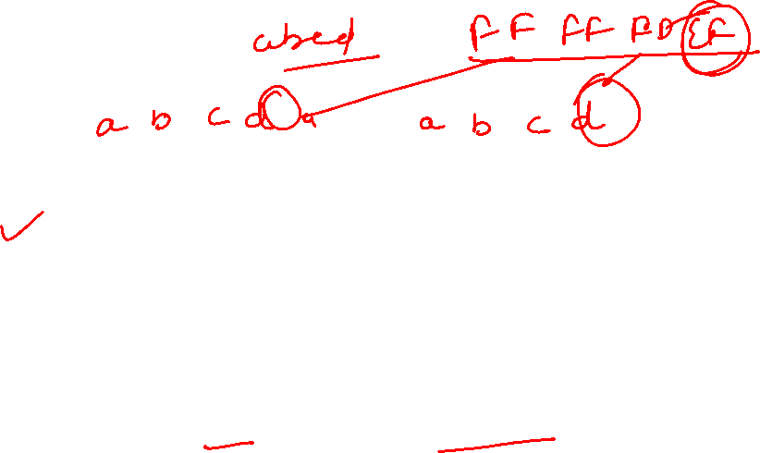
Big-Endian and Little-Endian Assignments
Big-Endian: lower byte addresses are used for the most significant bytes of the word
Little-Endian: opposite ordering. lower byte addresses are used for the less significant bytes of the word
W
ord
address
Byte address
Byte address
0
0
1
2
3
0
3
2
1
0
4
4
5
6
7
4
7
6
5
4
•
•
•
•
•
•
2
k
-
4
2
k
-
4
2
k
-
3
2
k
-
2
2
k
-
1
2
k
-
4
2
k
-
1
2
k
-
2
2
k
-
3
2
k
-
4
(a) Big-endian assignment
(b) Little-endian assignment
Figure 2.7. Byte and word addressing.

Slide 54
Memory Location, Addresses, and Operation
Address ordering of bytes
Word alignment
Words are said to be aligned in memory if they begin at a byte addr. that is a multiple of the num of bytes in a word.
16-bit word: word addresses: 0, 2, 4,….
32-bit word: word addresses: 0, 4, 8,….
64-bit word: word addresses: 0, 8,16,….
Access numbers, characters, and character strings

Slide 55
Memory Operation
Load (or Read or Fetch)
Copy the content. The memory content doesn’t change.
Address – Load
Registers can be used
Store (or Write)
Overwrite the content in memory
Address and Data – Store
Registers can be used

Slide 56
Instruction and Instruction Sequencing

Slide 57
“Must-Perform” Operations
Data transfers between the memory and the processor registers
Arithmetic and logic operations on data
Program sequencing and control
I/O transfers

Slide 58
Register Transfer Notation
Identify a location by a symbolic name standing for its hardware binary address (LOC, R0,…)
Contents of a location are denoted by placing square brackets around the name of the location (R1←[LOC], R3 ←[R1]+[R2])
Register Transfer Notation (RTN)

Slide 59

Assembly Language Notation
Represent machine instructions and programs.
Move LOC, R1 = R1←[LOC]
Add R1, R2, R3 = R3 ←[R1]+[R2]

Slide 60

CPU Organization
Single Accumulator
Result usually goes to the Accumulator
Accumulator has to be saved to memory quite often
General Register
Registers hold operands thus reduce memory traffic
Register bookkeeping
Stack
Operands and result are always in the stack

Slide 61
Instruction Formats
Three-Address Instructions
ADD R1, R2, R3 R1 ← R2 + R3
Two-Address Instructions
ADD R1, R2 R1 ← R1 + R2
One-Address Instructions
ADD M AC ← AC + M[AR]
Zero-Address Instructions
ADD TOS ← TOS + (TOS – 1)
RISC Instructions
Lots of registers. Memory is restricted to Load & Store
Instruction
Opcode
Operand(s) or Address(es)

Slide 62
Instruction Formats
Example: Evaluate (A+B) ∗ (C+D)
Three-Address
ADD R1, A, B ; R1 ← M[A] + M[B]
ADD R2, C, D ; R2 ← M[C] + M[D]
MUL X, R1, R2 ; M[X] ← R1 ∗ R2

Slide 63

Instruction Formats
Example: Evaluate (A+B) ∗ (C+D)
Two-Address
MOV R1, A ; R1 ← M[A]
ADD R1, B ; R1 ← R1 + M[B]
MOV R2, C ; R2 ← M[C]
ADD R2, D ; R2 ← R2 + M[D]
MUL R1, R2 ; R1 ← R1 ∗ R2
MOV X, R1 ; M[X] ← R1

Slide 64
Instruction Formats
Example: Evaluate (A+B) ∗ (C+D)
One-Address
LOAD A ; AC ← M[A]
ADD B ; AC ← AC + M[B]
STORE T ; M[T] ← AC
LOAD C ; AC ← M[C]
ADD D ; AC ← AC + M[D]
MUL T ; AC ← AC ∗ M[T]
STORE X ; M[X] ← AC

Slide 65
Instruction Formats
Example: Evaluate (A+B) ∗ (C+D)
RISC
LOAD R1, A ; R1 ← M[A]
LOAD R2, B ; R2 ← M[B]
LOAD R3, C ; R3 ← M[C]
LOAD R4, D ; R4 ← M[D]
ADD R1, R1, R2 ; R1 ← R1 + R2
ADD R3, R3, R4 ; R3 ← R3 + R4
MUL R1, R1, R3 ; R1 ← R1 ∗ R3
STORE X, R1 ; M[X] ← R1

Slide 66



Using Registers
Registers are faster
Shorter instructions
The number of registers is smaller (e.g. 32 registers need 5 bits)
Potential speedup
Minimize the frequency with which data is moved back and forth between the memory and processor registers.

Slide 67
Instruction Execution and Straight-Line Sequencing
Address
Contents
Assumptions:
- One memory operand
per instruction
- 32-bit word length
- Memory is byte
addressable
- Full memory address
can be directly specified
in a single-word instruction
Begin execution here
i
Move
A,R0
3-instruction
i
+ 4
Add
B,R0
program
segment
i
+ 8
Move
R0,C
A
B
Data for
the program
Two-phase procedure
Instruction fetch
Instruction execute
C
Page 43
Figure 2.8. A program for C ← [Α] + [Β].

Slide 68
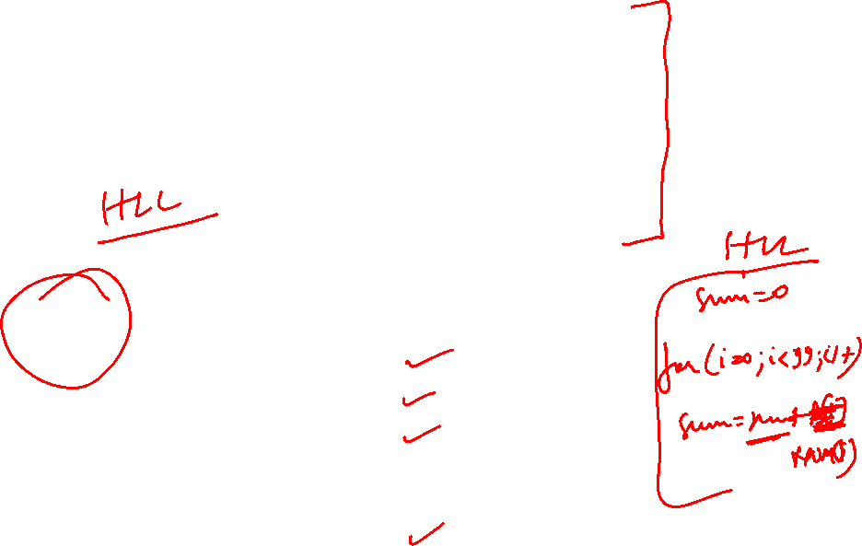
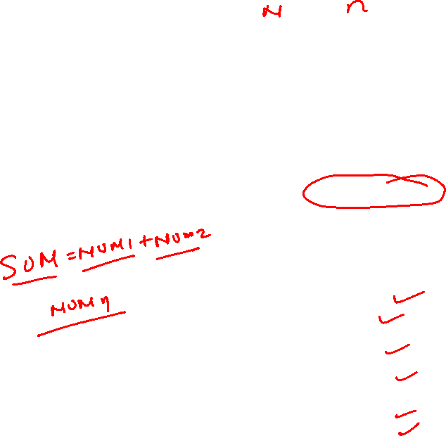
Branching
i
Move
NUM1,R0
i
+
4
Add
NUM2,R0
i
+
8
Add
NUM3,R0
•
•
•
i
+
4
n
-
4
Add
NUM
n
,R0
i
+
4
n
Move
R0,SUM
•
•
•
SUM
NUM1
NUM2
•
•
•
NUM
n
Figure 2.9. A straight-line program for adding n numbers.

Slide 69
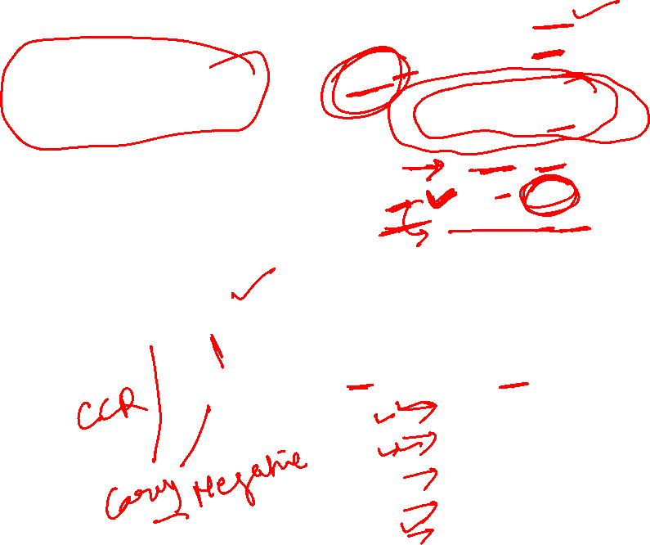
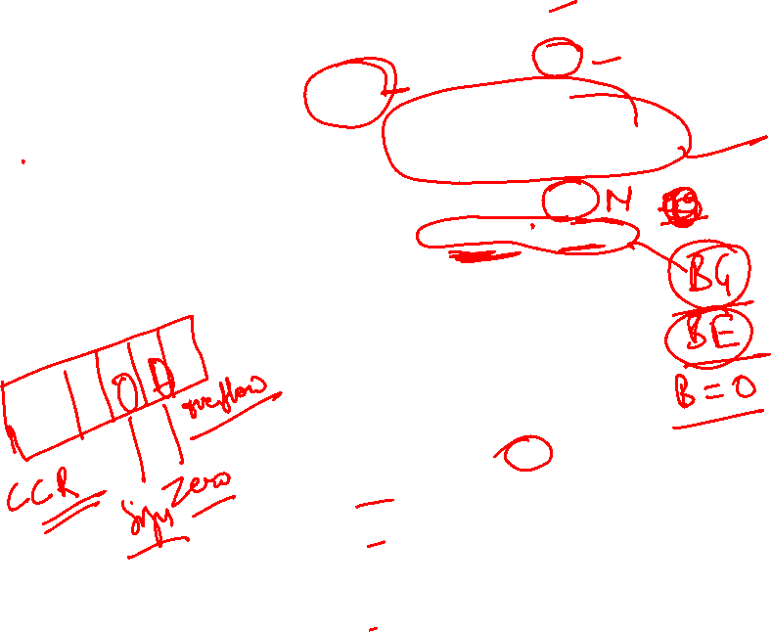
Branching
Move
N,R1
Clear
R0
LOOP
Determine address of
"Next" number and add
Program
"Next" number to R0
loop
Decrement
R1
Branch target
Branch>0
LOOP
Move
R0,SUM
Conditional branch
•
•
•
SUM
N
n
NUM1
Figure 2.10. Using a loop to add n numbers.
NUM2
•
•
•
NUM
n

Slide 70
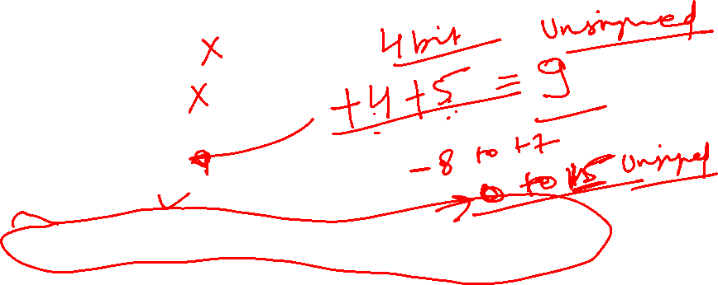
Condition Codes
Condition code flags
Condition code register / status register
N (negative)
Z (zero)
V (overflow)
C (carry)
Different instructions affect different flags

Slide 71
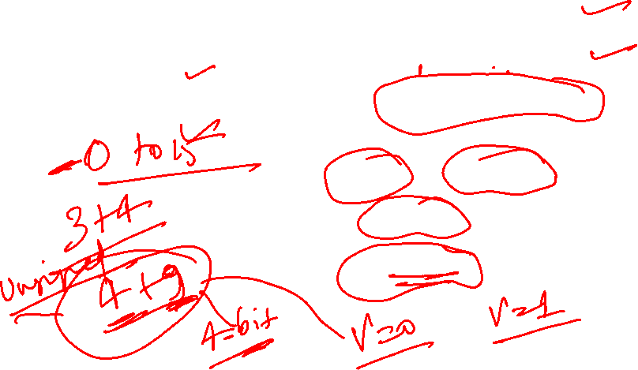
Conditional Branch Instructions
A: 1 1 1 1 0 0 0 0
Example:
A: 1 1 1 1 0 0 0 0
B: 0 0 0 1 0 1 0 0
+(−B): 1 1 1 0 1 1 0 0
1 1 0 1 1 1 0 0
C = 1
Z = 0
S = 1
V = 0

Slide 72
Status Bits
C_{n-1}
A
B
C_{n}
ALU
F
V
Z
S
C
F_{n-1}
Zero Check

Slide 73
Addressing Modes

Slide 74
Generating Memory Addresses
How to specify the address of branch target?
Can we give the memory operand address directly in a single Add instruction in the loop?
Use a register to hold the address of NUM1; then increment by 4 on each pass through the loop.

Slide 75
Addressing Modes
Implied
AC is implied in “ADD M[AR]” in “One-Address” instr.
TOS is implied in “ADD” in “Zero-Address” instr.
Immediate
The use of a constant in “MOV R1, 5”, i.e. R1 ← 5
Register
Indicate which register holds the operand
Instruction
Opcode
Mode
...

Slide 76
Addressing Modes
Register Indirect
Indicate the register that holds the number of the register that holds the operand
MOV R1, (R2)
Autoincrement / Autodecrement
Access & update in 1 instr.
Direct Address
Use the given address to access a memory location
R1
R2 = 3
R3 = 5

Slide 77
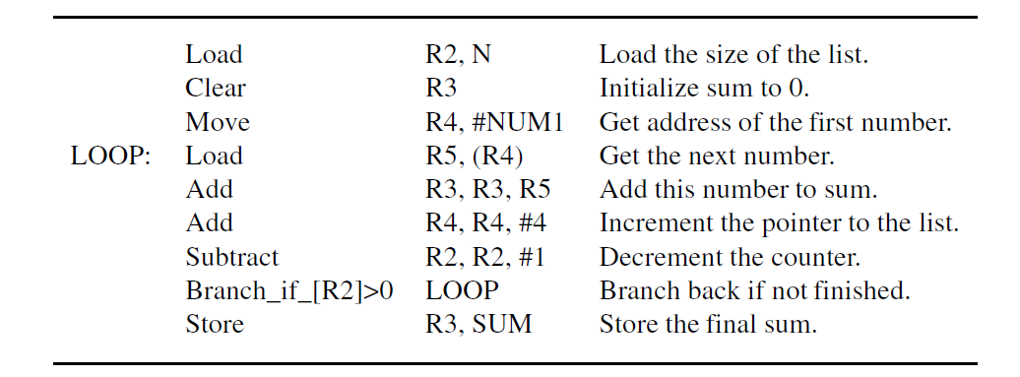

Slide 78
Addressing Modes
Indirect Address
Indicate the memory location that holds the address of the memory location that holds the data
Memory
AR = 101
100
101
0 1 0 4
102
103
104
1 1 0 A

Slide 79
Addressing Modes
Memory
Relative Address
EA = PC + Relative Addr
0
1
Program
PC = 2
2
+
100
Data
AR = 100
101
102
1 1 0 A
Could be Positive or Negative (2’s Complement)
103
104

Slide 80
Addressing Modes
Indexed
EA = Index Register + Relative Addr
Memory
Useful with “Autoincrement” or “Autodecrement”
XR = 2
+
100
AR = 100
101
Could be Positive or Negative (2’s Complement)
102
1 1 0 A
103
104

Slide 81
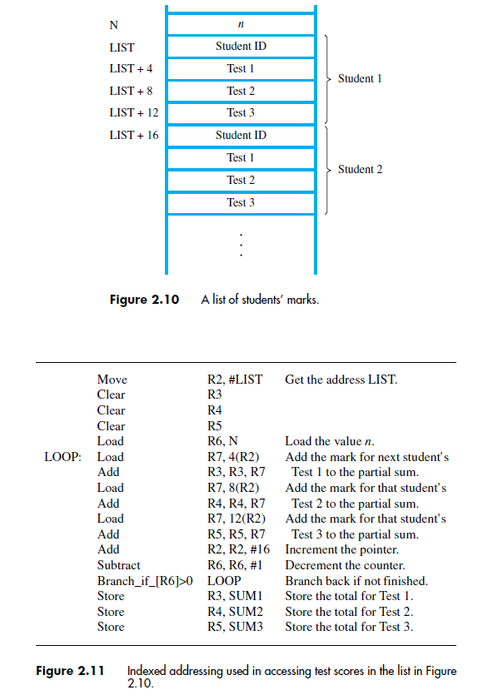

Slide 82
Addressing Modes
Base Register
EA = Base Register + Relative Addr
Memory
Could be Positive or Negative (2’s Complement)
AR = 2
+
100
0 0 0 5
BR = 100
101
0 0 1 2
102
0 0 0 A
Usually points to the beginning of an array
103
0 1 0 7
104
0 0 5 9

Slide 83
Addressing Modes
Name
Assem
bler
syn
tax
Addressing
function
The different ways in which the location of an operand is specified in an instruction are referred to as addressing modes.
Immediate
#V
alue
Op
erand
=
V
alue
Register
R
i
EA
=
R
i
Absolute
(Direct)
LOC
EA
=
LOC
Indirect
(R
i
)
EA
=
[R
i
]
(LOC)
EA
=
[LOC]
Index
X(R
i
)
EA
=
[R
i
]
+
X
Base
with
index
(R
i
,R
j
)
EA
=
[R
i
]
+
[R
j
]
Base
with
index
X(R
i
,R
j
)
EA
=
[R
i
]
+
[R
j
]
+
X
and
offset
Relative
X(PC)
EA
=
[PC]
+
X
Autoincremen
t
(R
i
)+
EA
=
[R
i
]
;
Incremen
t
R
i
Autodecrement
−
(R
i
)
Decremen
t
R
i
;
EA
=
[R
i
]

Slide 84
Indexing and Arrays
Index mode – the effective address of the operand is generated by adding a constant value to the contents of a register.
Index register
X(R_{i}): EA = X + [R_{i}]
The constant X may be given either as an explicit number or as a symbolic name representing a numerical value.
If X is shorter than a word, sign-extension is needed.

Slide 85
Indexing and Arrays
In general, the Index mode facilitates access to an operand whose location is defined relative to a reference point within the data structure in which the operand appears.
Several variations: (R_{i}, R_{j}): EA = [R_{i}] + [R_{j}] X(R_{i}, R_{j}): EA = X + [R_{i}] + [R_{j}]

Slide 86
Relative Addressing
Relative mode – the effective address is determined by the Index mode using the program counter in place of the general-purpose register.
X(PC) – note that X is a signed number
Branch>0 LOOP
This location is computed by specifying it as an offset from the current value of PC.
Branch target may be either before or after the branch instruction, the offset is given as a singed num.

Slide 87
Additional Modes
Autoincrement mode – the effective address of the operand is the contents of a register specified in the instruction. After accessing the operand, the contents of this register are automatically incremented to point to the next item in a list.
(R_{i})+. The increment is 1 for byte-sized operands, 2 for 16-bit operands, and 4 for 32-bit operands.
Autodecrement mode: -(R_{i}) – decrement first
Move
N,R1
Move
#NUM1,R2
Initialization
Clear
R0
LOOP
Add
(R2)+,R0
Decrement
R1
Branch>0
LOOP
Move
R0,SUM
Figure 2.16. The Autoincrement addressing mode used in the program of Figure 2.12.

Slide 88
Data Transfer Instructions
Mode | Assembly | Register Transfer
Direct address | LD ADR | AC ← M[ADR]
Indirect address | LD @ADR | AC ← M[M[ADR]]
Relative address | LD $ADR | AC ← M[PC+ADR]
Immediate operand | LD #NBR | AC ← NBR
Index addressing | LD ADR(X) | AC ← M[ADR+XR]
Register | LD R1 | AC ← R1
Register indirect | LD (R1) | AC ← M[R1]
Autoincrement | LD (R1)+ | AC ← M[R1], R1 ← R1+1

Slide 89
For(i=0;i<10;i++)C[i]=A[i]+B[i]
.data
A: .word 1, 2, 3, 4, 5 # Array A
B: .word 10, 20, 30, 40, 50 # Array B
C: .space 20 # Array C, reserved space for 5 integers
.text
.globl main
main:
li $t0, 5 # Mov #10, R1 # Number of elements (length of arrays)
la $t1, A # Mov #A, R2 # Load address of array A into $t1
la $t2, B # Mov #B, R3 # Load address of array B into $t2
la $t3, C # Mov #C, R5 # Load address of array C into $t3
li $t4, 0 # Mov #0, R6 # Initialize index register i = 0
Loop:
beq $t4, $t0, Exit # Branch if i == 5 (end of loop)
lw $t5, 0($t1) # Mov (R2), R4 # Load A[i] into $t5
lw $t6, 0($t2) # Mov (R3), R4 # Load B[i] into $t6
add $t7, $t5, $t6 # Add R4, (R3) # Add A[i] + B[i], store in $t7
sw $t7, 0($t3) # Mov R4, (R5) # Store the result in C[i]
addi $t1, $t1, 4 # Increment pointer for A[i]
addi $t2, $t2, 4 # Increment pointer for B[i]
addi $t3, $t3, 4 # Increment pointer for C[i]
addi $t4, $t4, 1 # Increment index i
j Loop # Jump back to Loop
Exit:
# Exit the program (for simulators)
li $v0, 10 # Exit system call
syscall

Slide 90
Addressing Modes | Applications
Immediate Addressing Mode | To initialize registers to a constant value
Direct Addressing Mode and Register Direct Addressing Mode | To access static data To implement variables
Indirect Addressing Mode and Register Indirect Addressing Mode | To implement pointers because pointers are memory locations that store the address of another variable To pass array as a parameter because array name is the base address and pointer is needed to point the address
Relative Addressing Mode | For program relocation at run time i.e. for position independent code To change the normal sequence of execution of instructions For branch type instructions since it directly updates the program counter
Index Addressing Mode | For array implementation or array addressing For records implementation
Base Register Addressing Mode | For writing relocatable code i.e. for relocation of program in memory even at run time For handling recursive procedures
Auto-increment Addressing Mode and Auto-decrement Addressing Mode | For implementing loops For stepping through arrays in a loop For implementing a stack as push and pop

Slide 91
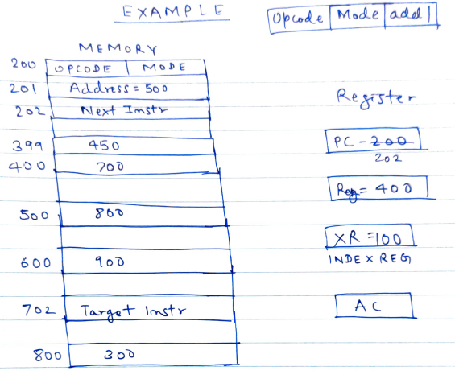

Slide 92
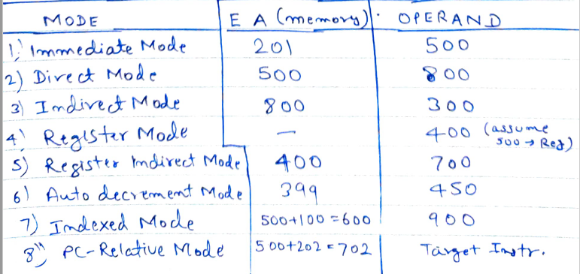

Slide 93
Indexing and Arrays
Index mode – the effective address of the operand is generated by adding a constant value to the contents of a register.
Index register
X(R_{i}): EA = X + [R_{i}]
The constant X may be given either as an explicit number or as a symbolic name representing a numerical value.
If X is shorter than a word, sign-extension is needed.

Slide 94
Indexing and Arrays
In general, the Index mode facilitates access to an operand whose location is defined relative to a reference point within the data structure in which the operand appears.
Several variations: (R_{i}, R_{j}): EA = [R_{i}] + [R_{j}] X(R_{i}, R_{j}): EA = X + [R_{i}] + [R_{j}]

Slide 95
Relative Addressing
Relative mode – the effective address is determined by the Index mode using the program counter in place of the general-purpose register.
X(PC) – note that X is a signed number
Branch>0 LOOP
This location is computed by specifying it as an offset from the current value of PC.
Branch target may be either before or after the branch instruction, the offset is given as a singed num.

Slide 96
Additional Modes
Autoincrement mode – the effective address of the operand is the contents of a register specified in the instruction. After accessing the operand, the contents of this register are automatically incremented to point to the next item in a list.
(R_{i})+. The increment is 1 for byte-sized operands, 2 for 16-bit operands, and 4 for 32-bit operands.
Autodecrement mode: -(R_{i}) – decrement first
Move
N,R1
Move
#NUM1,R2
Initialization
Clear
R0
LOOP
Add
(R2)+,R0
Decrement
R1
Branch>0
LOOP
Move
R0,SUM
Figure 2.16. The Autoincrement addressing mode used in the program of Figure 2.12.

Slide 97
Data Manipulation Instructions
Arithmetic
Logical & Bit Manipulation
Shift
Name | Mnemonic
Increment | INC
Decrement | DEC
Add | ADD
Subtract | SUB
Multiply | MUL
Divide | DIV
Add with carry | ADDC
Subtract with borrow | SUBB
Negate | NEG
Name | Mnemonic
Clear | CLR
Complement | COM
AND | AND
OR | OR
Exclusive-OR | XOR
Clear carry | CLRC
Set carry | SETC
Complement carry | COMC
Enable interrupt | EI
Disable interrupt | DI
Name | Mnemonic
Logical shift right | SHR
Logical shift left | SHL
Arithmetic shift right | SHRA
Arithmetic shift left | SHLA
Rotate right | ROR
Rotate left | ROL
Rotate right through carry | RORC
Rotate left through carry | ROLC

Slide 98
Program Control Instructions
Name | Mnemonic
Branch | BR
Jump | JMP
Skip | SKP
Call | CALL
Return | RET
Compare (Subtract) | CMP
Test (AND) | TST
Subtract A – B but don’t store the result
1
0
1
1
0
0
0
1
0
0
0
0
1
0
0
0
Mask
0
0
0
0
0
0
0
0

Slide 99
Conditional Branch Instructions
Mnemonic | Branch Condition | Tested Condition
BZ | Branch if zero | Z = 1
BNZ | Branch if not zero | Z = 0
BC | Branch if carry | C = 1
BNC | Branch if no carry | C = 0
BP | Branch if plus | S = 0
BM | Branch if minus | S = 1
BV | Branch if overflow | V = 1
BNV | Branch if no overflow | V = 0

Slide 100
Additional Instructions

Slide 101
Logical Shifts
Logical shift – shifting left (LShiftL) and shifting right (LShiftR)
C
R0
0
before:
0
0
1
1
1
0
.
.
.
0
1
1
after:
1
1
1
0
.
.
.
0
1
1
0
0
(a) Logical shift left
LShiftL #2,R0
0
R0
C
before:
0
1
1
1
0
.
.
.
0
1
1
0
after:
0
0
0
1
1
1
0
.
.
.
0
1
(b) Logical shift r
ight
LShiftR #2,R0

Slide 102
Arithmetic Shifts
R0
C
before:
1
0
0
1
1
.
.
.
0
1
0
0
after:
1
1
1
0
0
1
1
.
.
.
0
1
(c) Ar
ithmetic shift r
ight
AShiftR #2,R0

Slide 103
Rotate
C
R0
before:
0
0
1
1
1
0
.
.
.
0
1
1
after:
1
1
1
0
.
.
.
0
1
1
0
1
(a) Rotate left without carr
y
RotateL #2,R0
C
R0
before:
0
0
1
1
1
0
.
.
.
0
1
1
after:
1
1
1
0
.
.
.
0
1
1
0
0
(b) Rotate left with carr
y
RotateLC #2,R0
R0
C
before:
0
1
1
1
0
.
.
.
0
1
1
0
after:
1
1
0
1
1
1
0
.
.
.
0
1
(c) Rotate r
ight without carr
y
RotateR #2,R0
R0
C
before:
0
1
1
1
0
.
.
.
0
1
1
0
after:
1
0
0
1
1
1
0
.
.
.
0
1
(d) Rotate r
ight with carr
y
RotateRC #2,R0
Figure 2.32. Rotate instructions.

Slide 104
Multiplication and Division
Not very popular (especially division)
Multiply R_{i}, R_{j} R_{j} ← [R_{i}] х [R_{j}]
2n-bit product case: high-order half in R(j+1)
Divide R_{i}, R_{j} R_{j} ← [R_{i}] / [R_{j}]
Quotient is in Rj, remainder may be placed in R(j+1)

Slide 105
Encoding of Machine Instructions

Slide 106
Encoding of Machine Instructions
Assembly language program needs to be converted into machine instructions. (ADD = 0100 in ARM instruction set)
In the previous section, an assumption was made that all instructions are one word in length.
OP code: the type of operation to be performed and the type of operands used may be specified using an encoded binary pattern
Suppose 32-bit word length, 8-bit OP code (how many instructions can we have?), 16 registers in total (how many bits?), 3-bit addressing mode indicator.
Add R1, R2
Move 24(R0), R5
LshiftR #2, R0
Move #$3A, R1
Branch>0 LOOP
8
7
7
10
OP code
Source
Dest
Other info
(a) One-word instruction

Slide 107
Encoding of Machine Instructions
What happens if we want to specify a memory operand using the Absolute addressing mode?
Move R2, LOC
14-bit for LOC – insufficient
Solution – use two words
OP code
Source
Dest
Other info
Memory address/Immediate operand
(b) Two-word instruction

Slide 108
Encoding of Machine Instructions
Then what if an instruction in which two operands can be specified using the Absolute addressing mode?
Move LOC1, LOC2
Solution – use two additional words
This approach results in instructions of variable length. Complex instructions can be implemented, closely resembling operations in high-level programming languages – Complex Instruction Set Computer (CISC)

Slide 109
Encoding of Machine Instructions
If we insist that all instructions must fit into a single 32-bit word, it is not possible to provide a 32-bit address or a 32-bit immediate operand within the instruction.
It is still possible to define a highly functional instruction set, which makes extensive use of the processor registers.
Add R1, R2 ----- yes
Add LOC, R2 ----- no
Add (R3), R2 ----- yes

